Slide 1
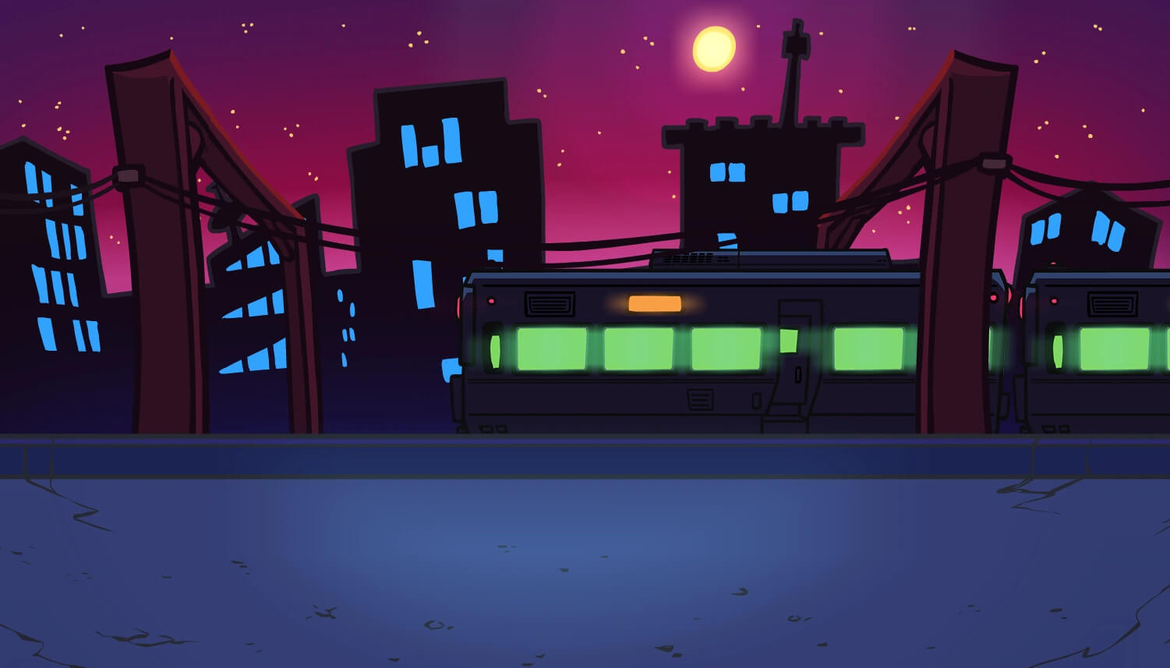

eats by YOU
Presented by IEEE @ UCF
Notes:
Make small talk to ease the audience (ex. Hows your lunch)
What music do you like? How *do* you listen to music (speaker? headphones?)
Objective: Today, we will create a speaker with simple components: coil of wire, magnet, electricity and create our own paper speakers :D
Credibility: We are the Institute of Electrical and Electronics Engineers!

Slide 2
Notes:
Vienna Slide

Slide 3
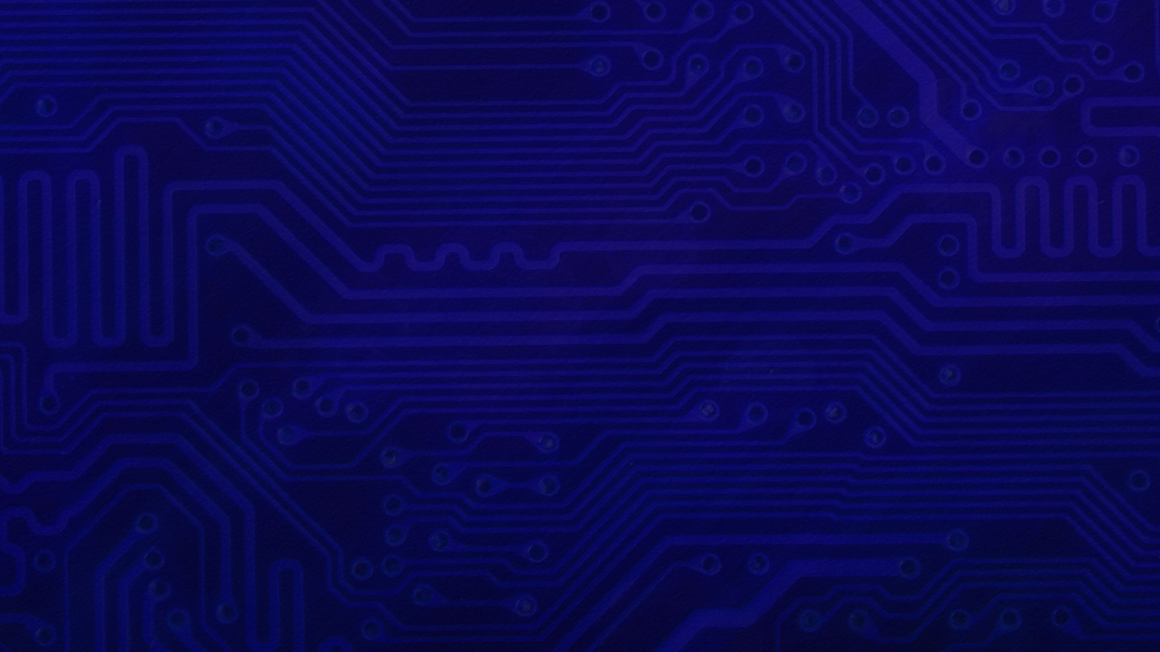



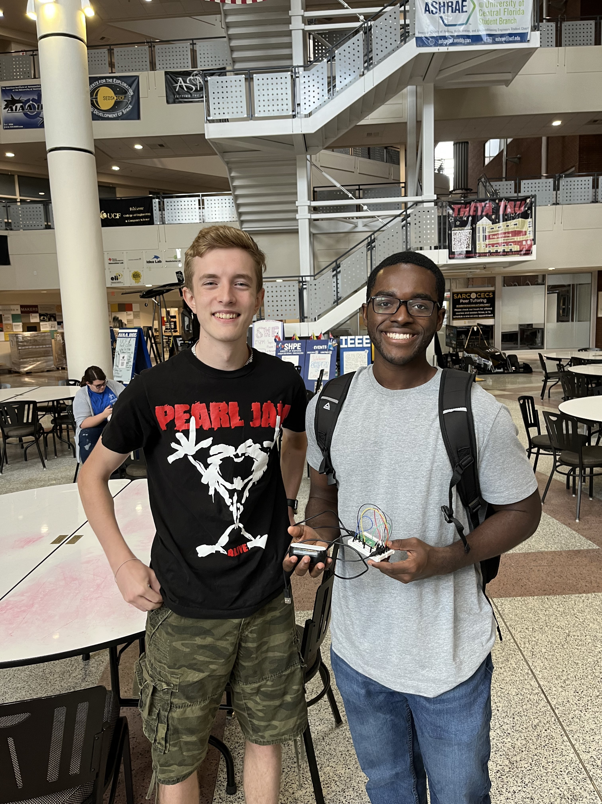

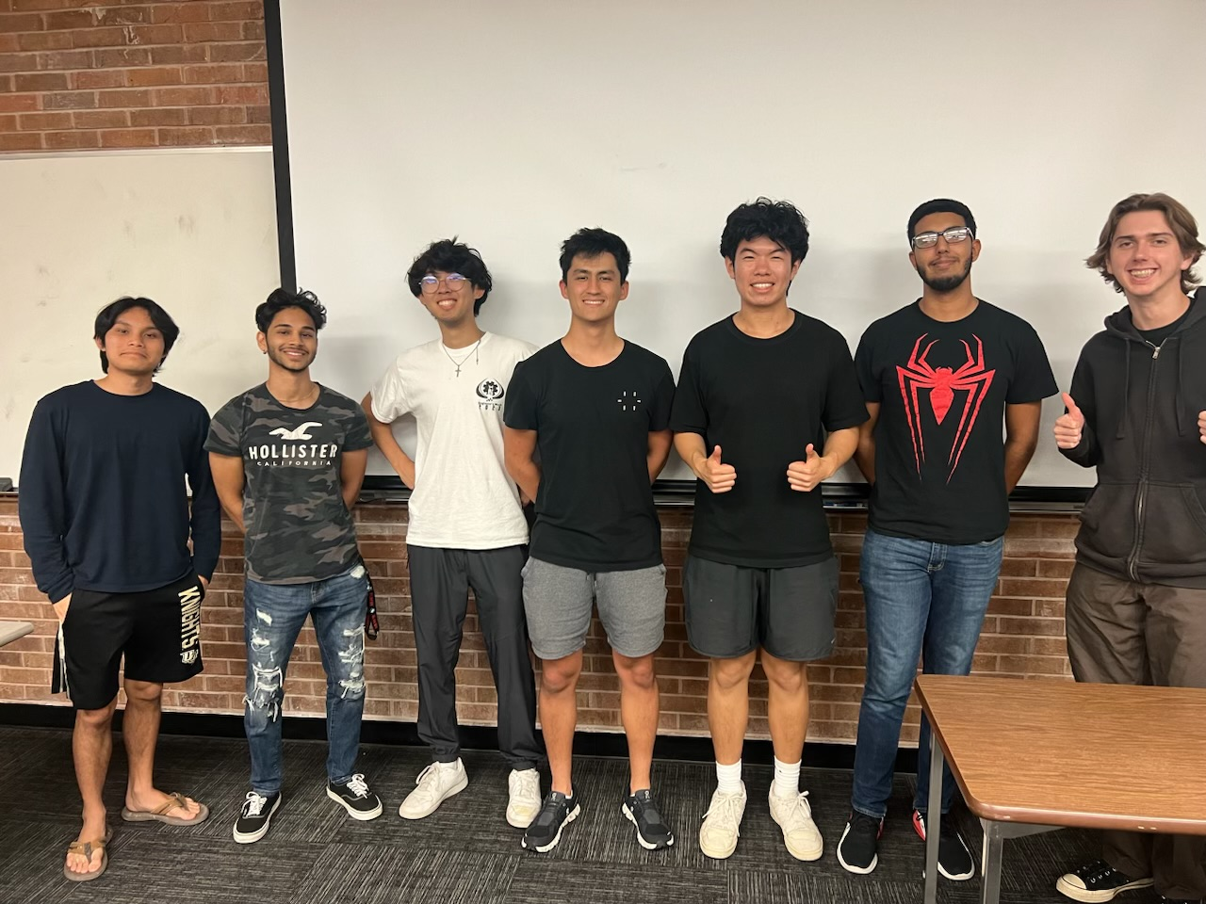

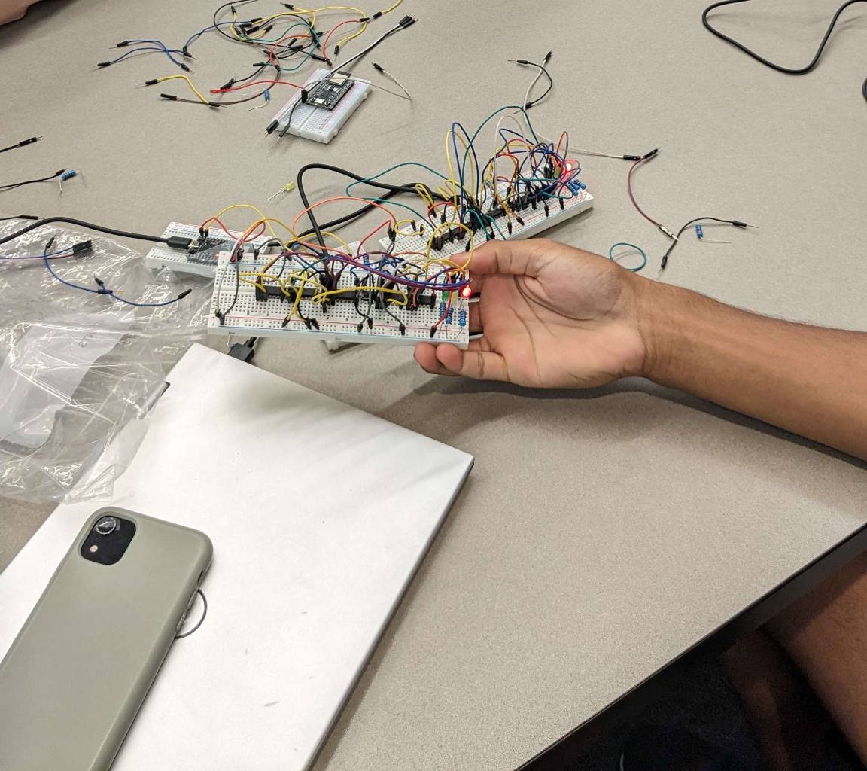
ADVANCING TECHNOLOGY
FOR HUMANITY!
IEEE UCF
I n s t i t u t e o f E l e c t r i c a l a n d
E l e c t r o n i c s E n g i n e e r s
Social Media!
Notes:
IEEE is an engineering student organization in UCF we host workshops and projects
DO NOT go into depth; questions at the end
Introduce Volunteers

Slide 4
Notes:
Vienna Slide
Before we

Slide 5
What is sound?
Notes:
“Who here has heard about sound waves ? What can you tell me about them”
Forshadow; DO NOT ANSWER Wavy air All we need to know is that soundwaves have frequency and amplitude

Slide 6

What is a speaker ?
Notes:
So what is a speaker ? Piston pushes air tehe
Foreshadow: DO NOT ANWER We have some digital, electronic input

Slide 7
Notes:
Vienna Slide

Slide 8
Magnetic Field
Notes:
Transition: Let’s begin by learning about how magnetic fields work.

Slide 9
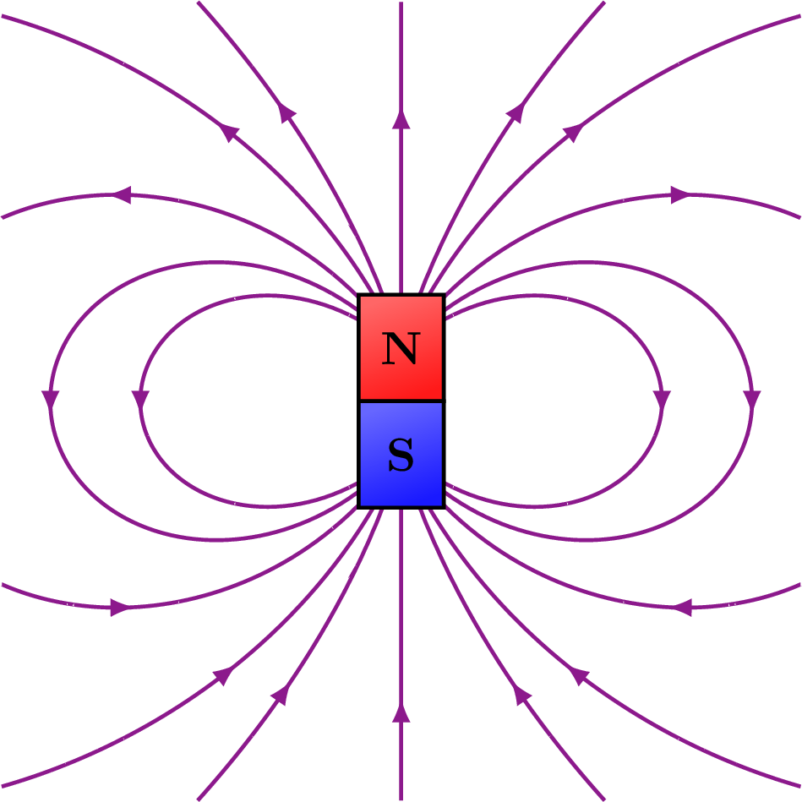
Magnetic Fields
What are magnets?
North and South Pole
“Invisible forces” from North to South poles

Slide 10
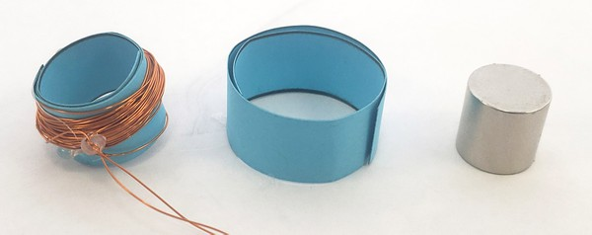
Magnet Types
Permanent
“Always on”
Electromagnet
Current runs through coil
Electromagnetic field generated

Slide 11
Notes:
Vienna Slide

Slide 12
Electromagnetic Movement

Slide 13
Electromagnetic Forces
Same poles repel
Opposite poles attract

Slide 14
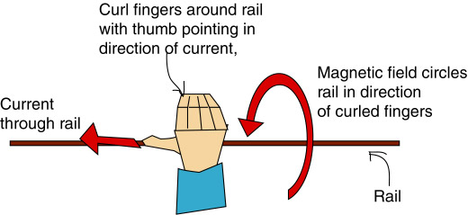
Right Hand Rule

Slide 15
Electromagnetic Forces in Speakers
Cone: amplifier
Coil: electromagnet
Permanent Magnet: Reacts with the coil to attract/repel

Slide 16
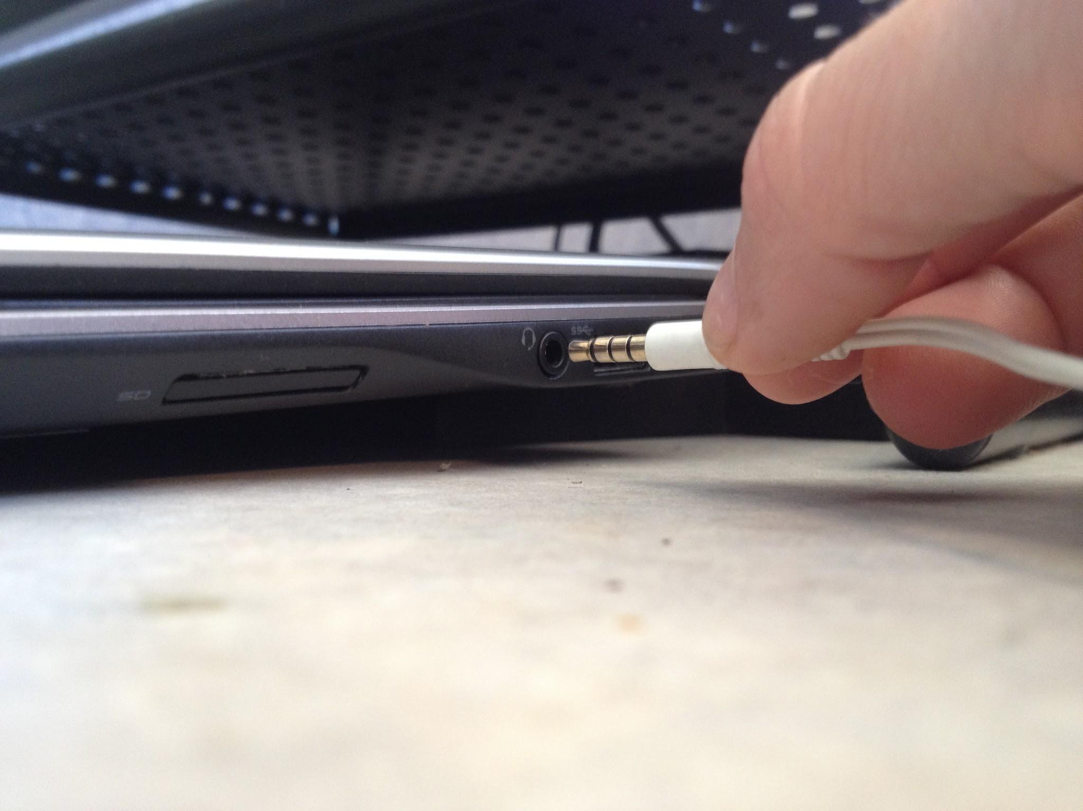
Electromagnetic Forces in Speakers
Your device sends an electric signal that continuously sends varying current
The alternating current creates a changing magnetic field around the current
These forces create vibrations

Slide 17
Notes:
Vienna Slide

Slide 18
Generation of Sound

Slide 19
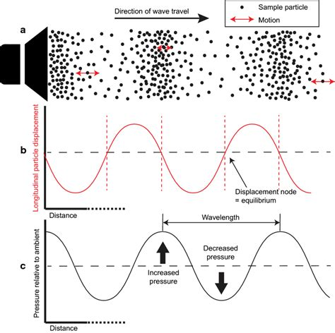
Speaker Cone
Coil vibrates, vibrates the cone
Pushes and pulls molecules
Sound waves are generated!
Sound: a body (ex. speaker) that causes molecules to vibrate through a medium (ex. air)

Slide 20
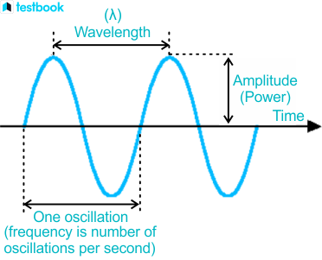

Slide 21
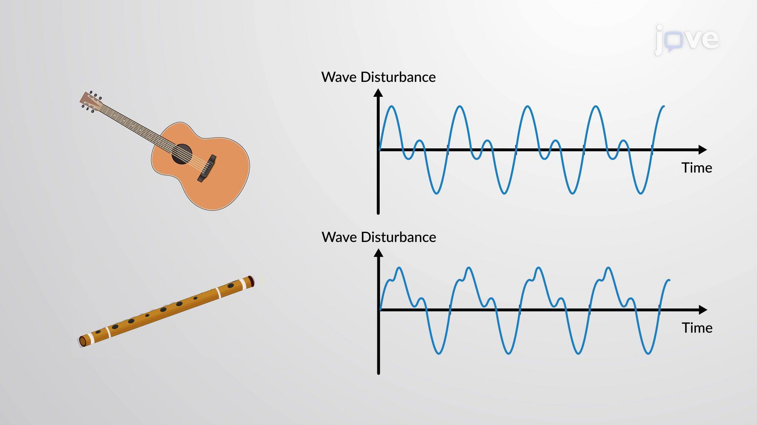
Sound is a wave (cont.)
Vibrations speed determine pitch and frequency
Amplitude determines intensity
What’s the equation for frequency?
speed/wavelength = frequency

Slide 22
Hit Play!

Slide 23
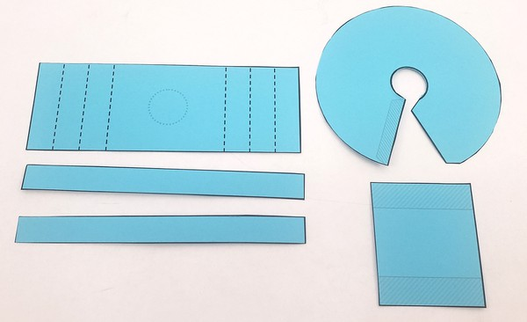
Step 1
Cone
Folds
Bottom

Slide 24
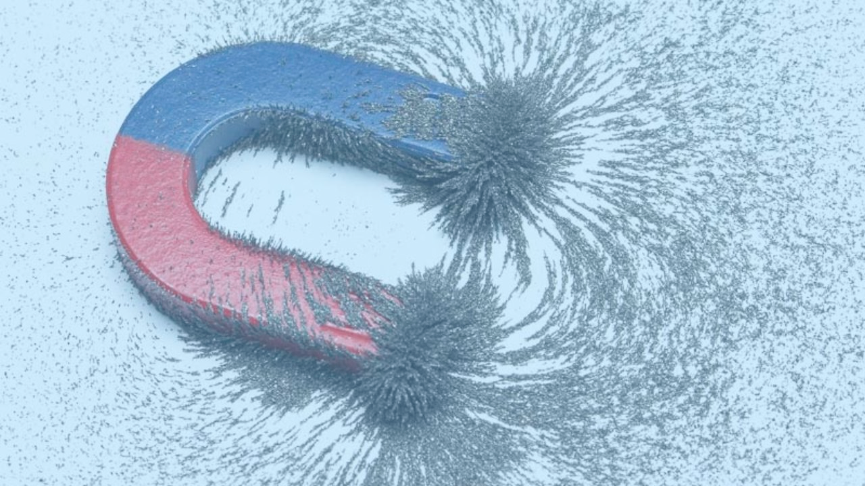
First steps :

Slide 25
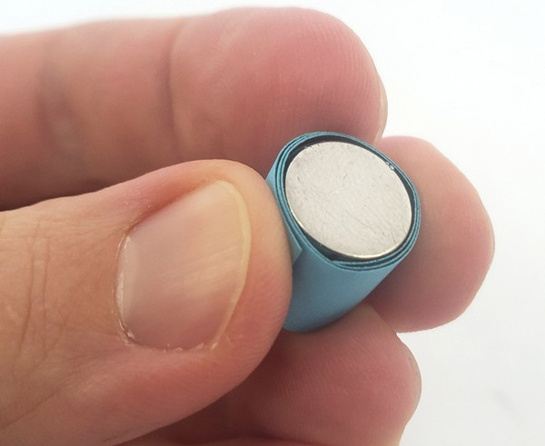
Step 2
Wrap (A) strip around magnet and glue

Slide 26
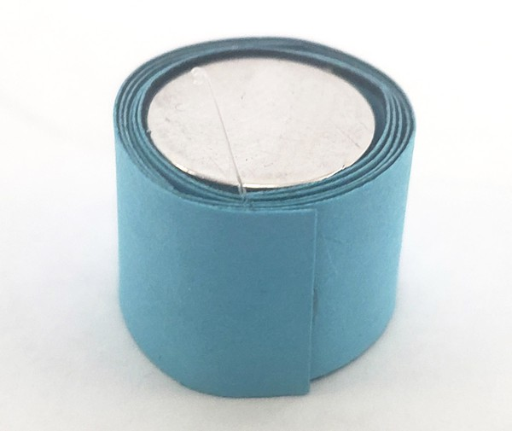
Step 3
Wrap (B) strip around (A)
DO NOT GLUE ONTO (A)

Slide 27
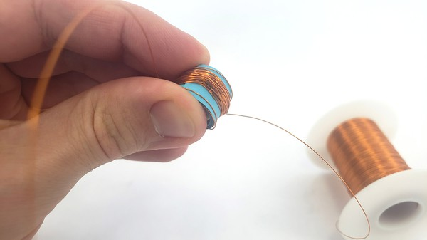
Step 2
Wrap wire 100 times around the small cylinder

Slide 28
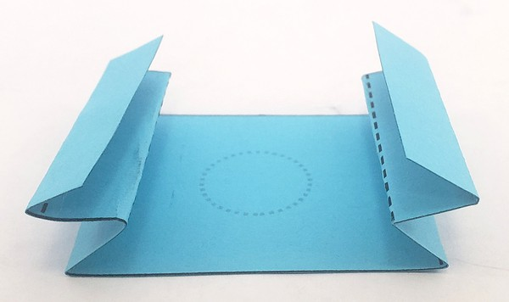
Step 3
Fold “accordion style”
Fold inward
Then outwards
Then inwards

Slide 29
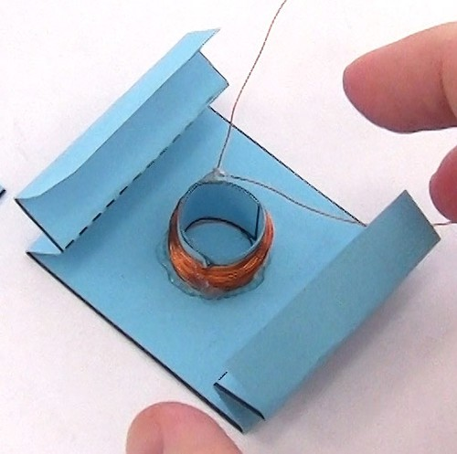
Step 4
Glue Coil in center

Slide 30
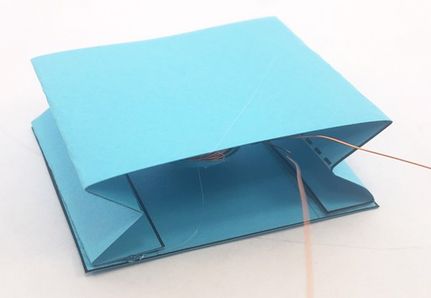
Step 5
Glue bottom on

Slide 31
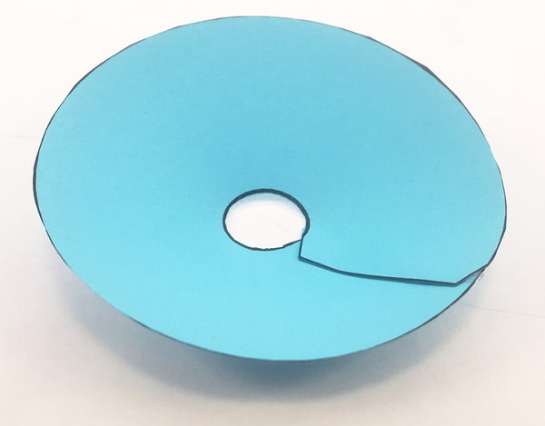
Step 6
Assemble Cone

Slide 32
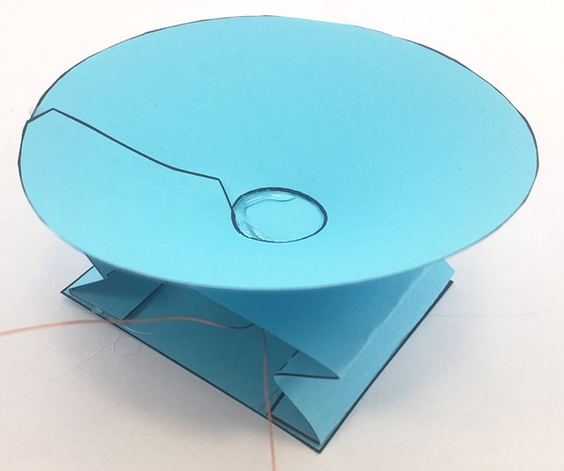
Step 7
Attach Cone

Slide 33
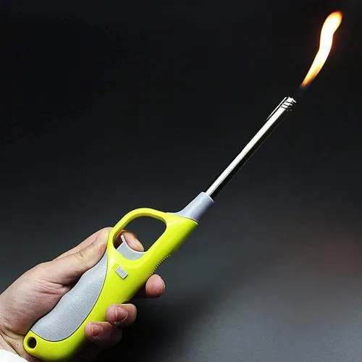
Step 10
De-Enamel the wire (Raise your hand)

Slide 34
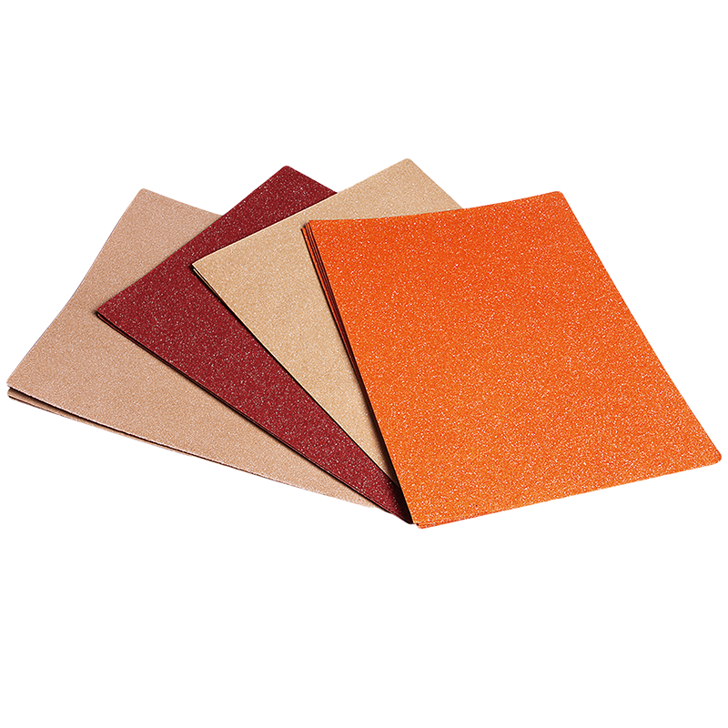
Step 8
Sandpaper the ends of the wires
(should become a different color)

Slide 35
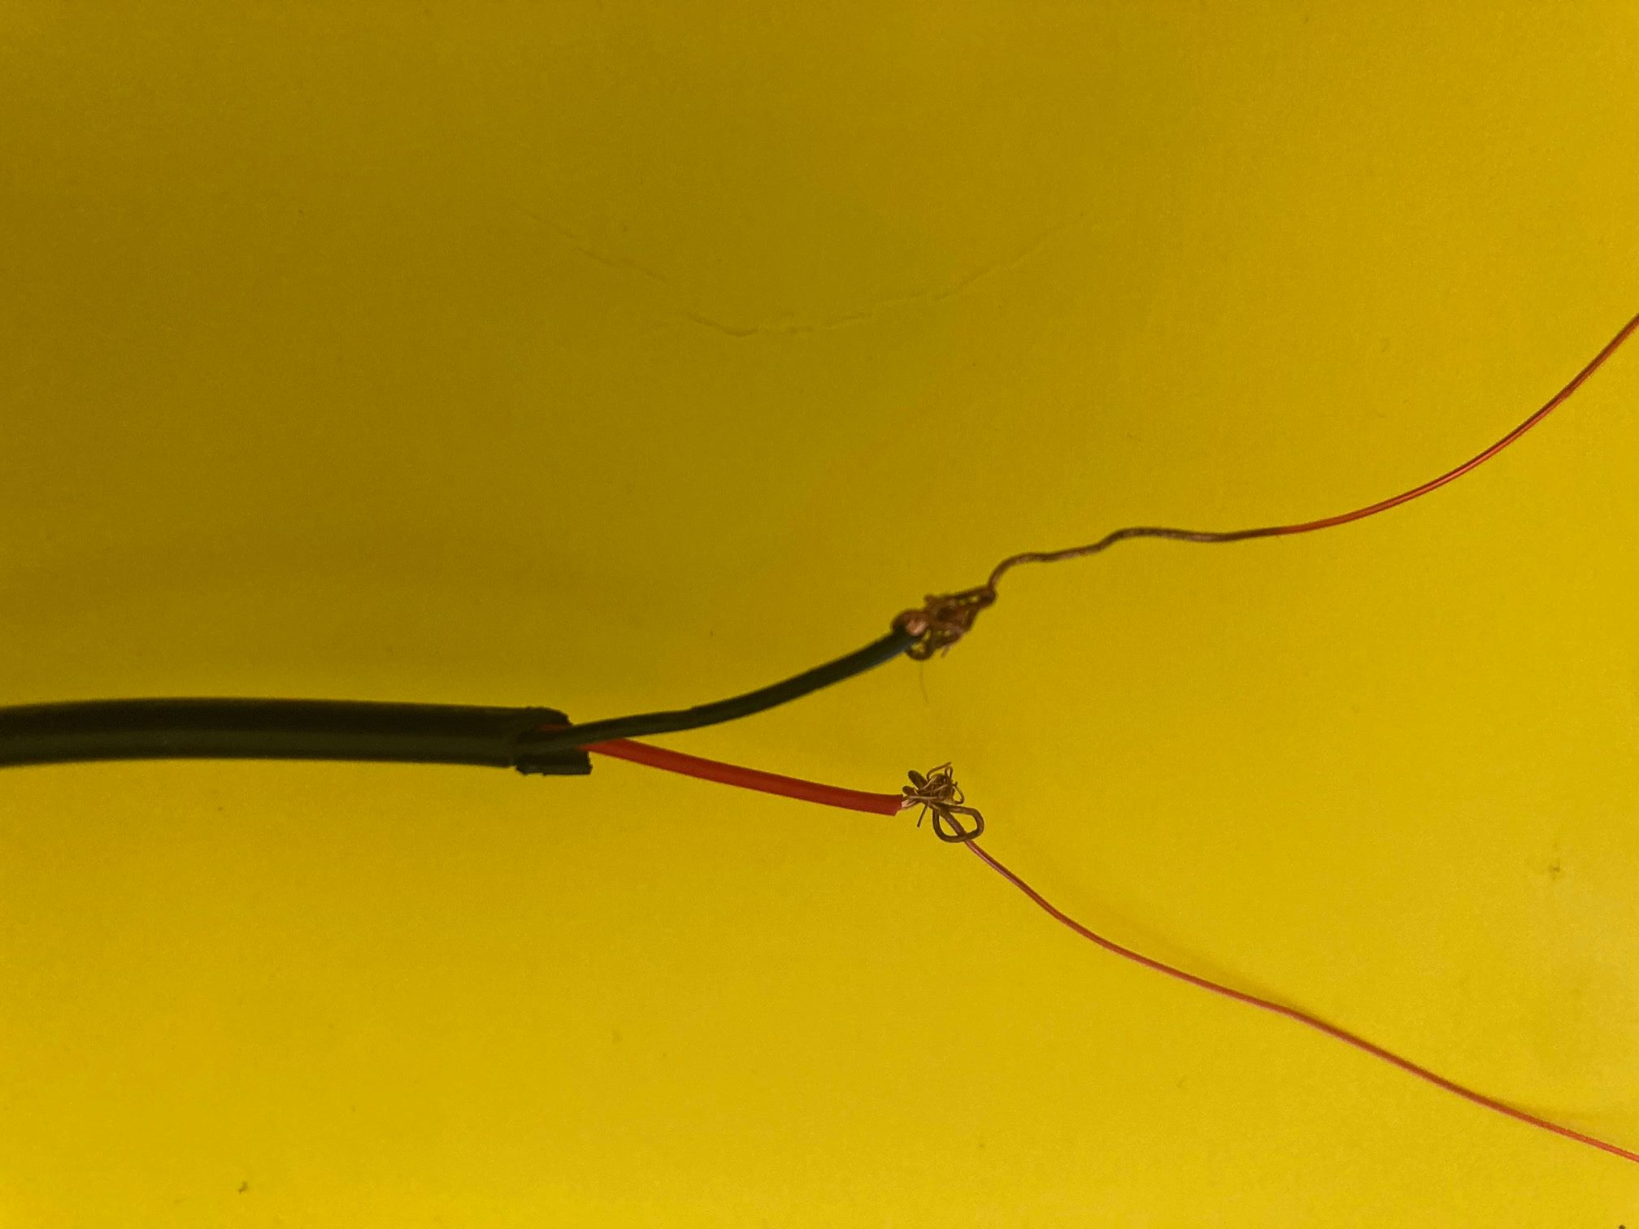
Step 9
Hand your wires to a volunteer to Solder on

Slide 37


Slide 38
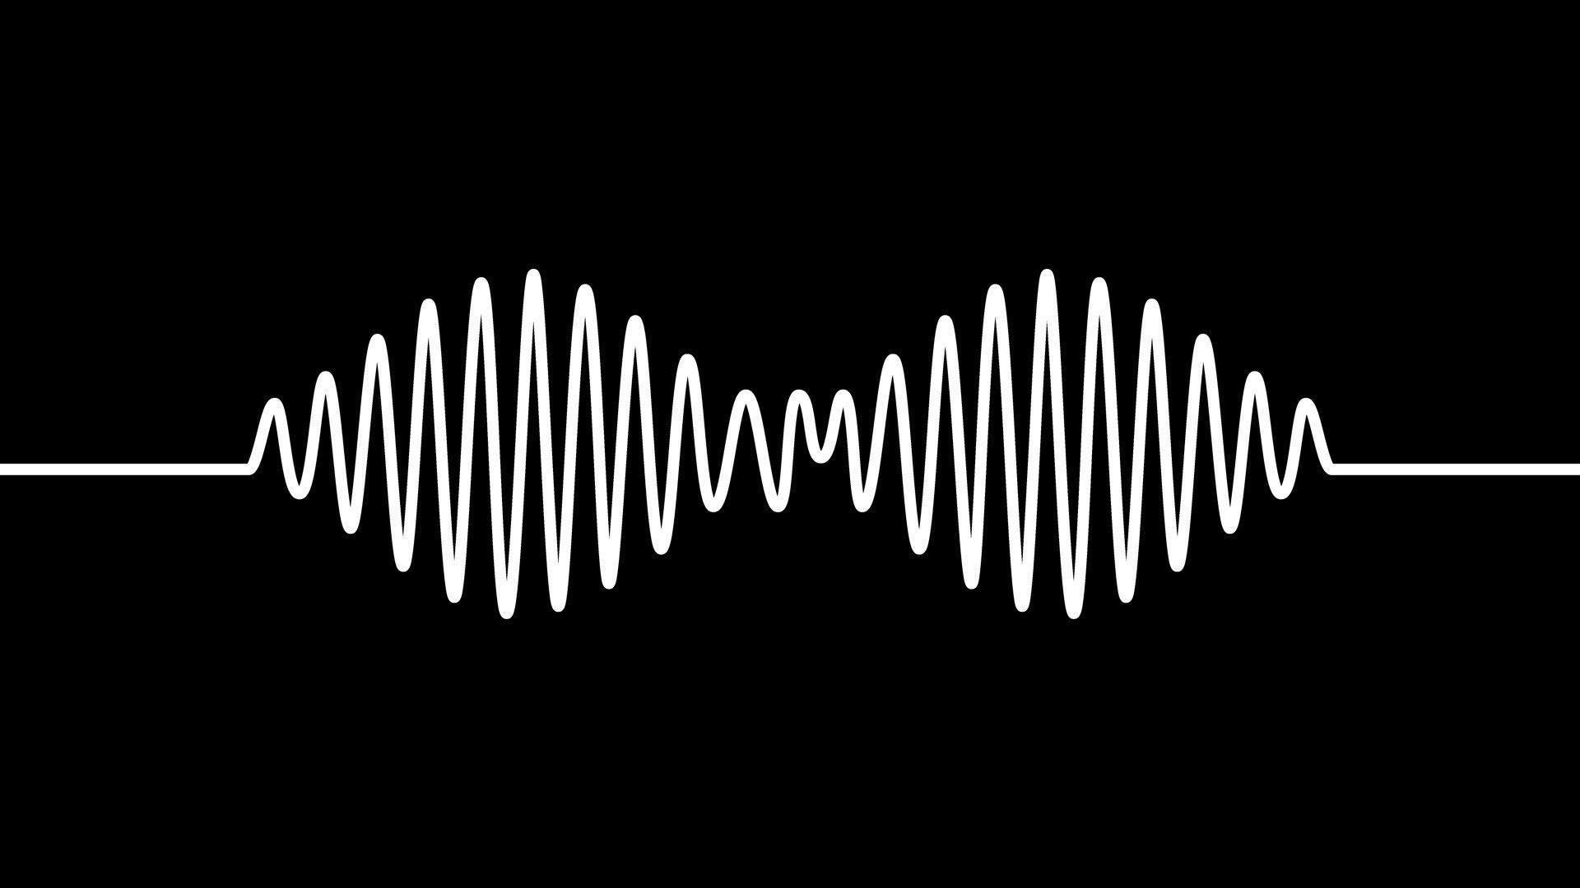
Thank You
IEEE UCF

Slide 39
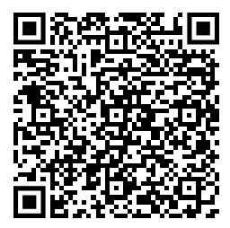
Do it at home!

